Slide 1

Wireline Data Control
Huw Rossiter
Business Development Manager
Surtron Technologies
14th February 2015
www.surtron.com.au

Slide 2
Contents
1. Introduction
2. Timeline of Data QC
3. Review of some common Data QC issues

Slide 3
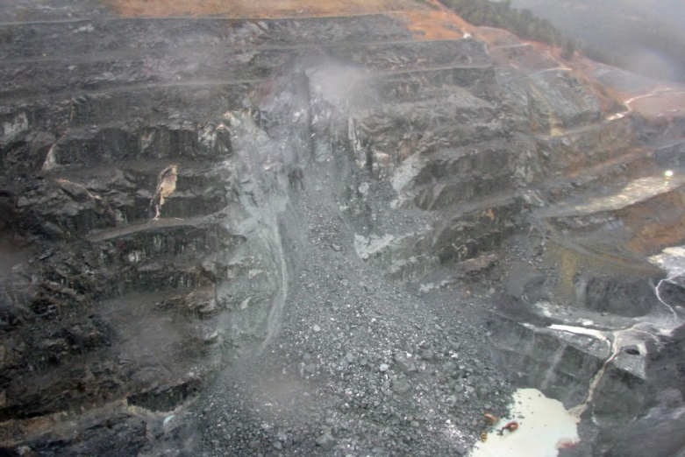

Introduction
Why is data QC important when gathering wireline data?
Why is accurate file management and record keeping important?

Slide 4
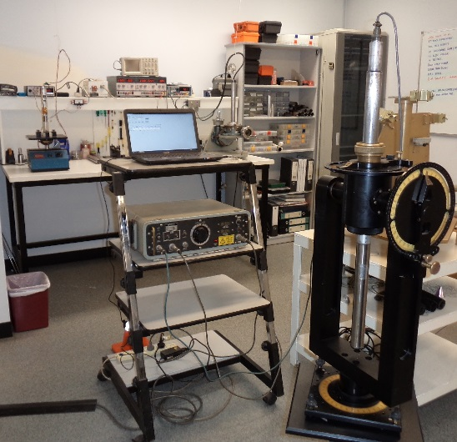
Pre-mobilisation
Logging Company
Equipment R&M
Shop Calibrations
Are they suitable for the resource type?
Client/ Geologist
Understanding of the tool limits and accuracies
Is there anything in the area that might affect the data?
Temperature & Pressure
Magnetics
What is the downhole environment going to be?
Chip/ RC/ Diamond hole
Hole size
Drilling fluid
Where is the water table?

Slide 5
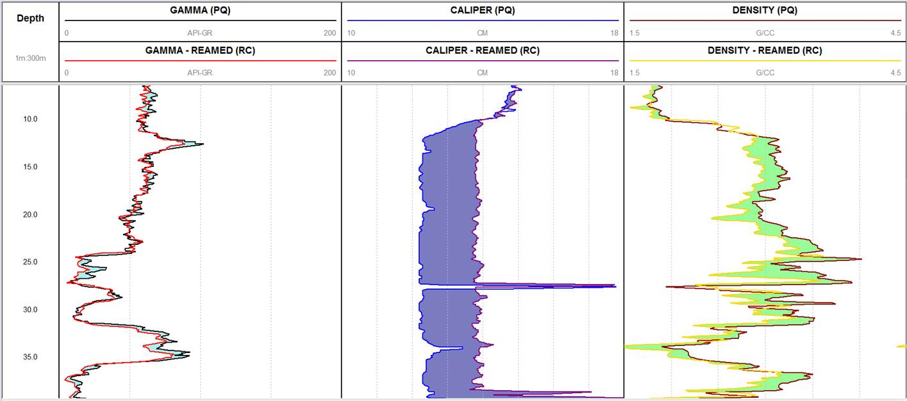
Example - Hole size on density

Slide 6
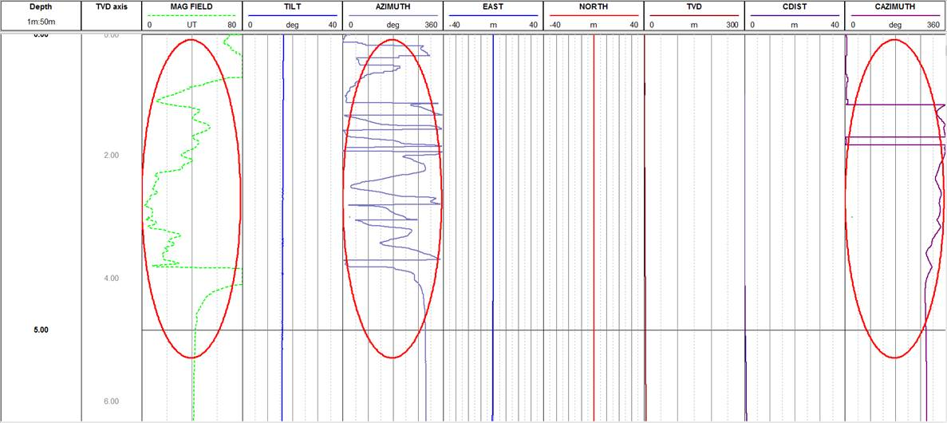
Example - Magnetic effects on deviation data

Slide 7
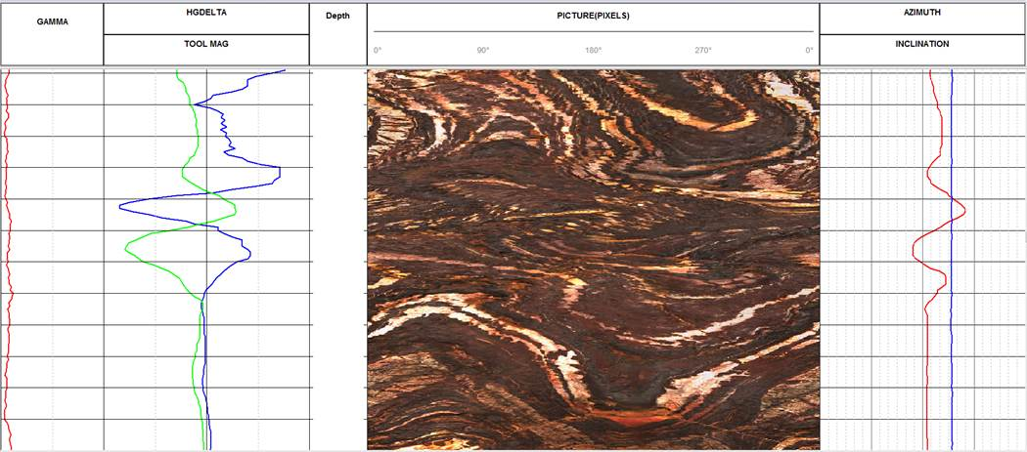
Example - Magnetic effects on televiewer

Slide 8
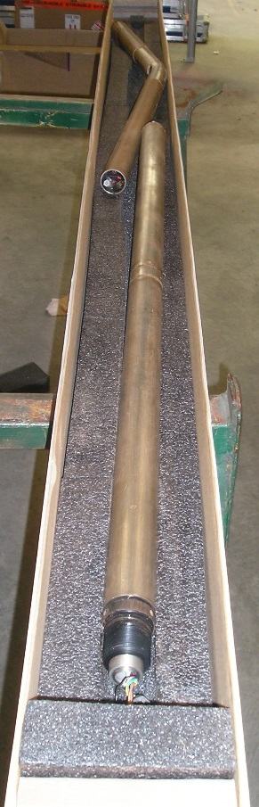
Start of Program Plan
Prove equipment serviceability
Gear damage
Site Level Calibrations
Depth calibration and repeatability
Onsite communication
End of campaign tie-off log

Slide 9
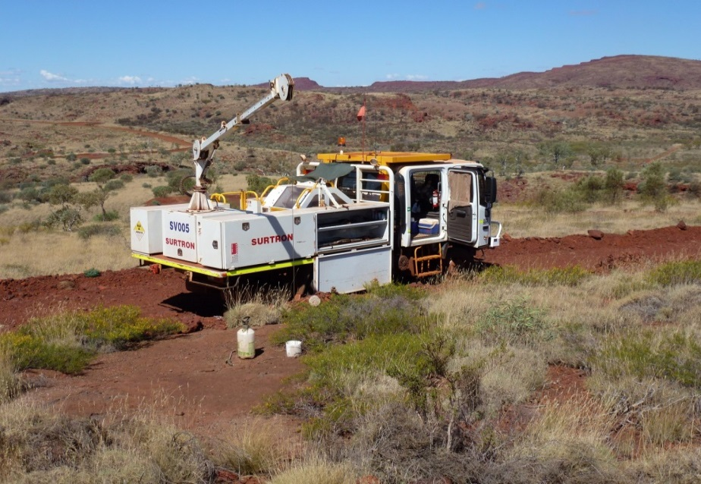
Performing Logging
Live data assessment
Does the data look as expected?
Cross log checks
Processed log checks
Software based checks
Manual checks
Repeat Logs
Equipment Change-Out
Data Centre Review and Validation

Slide 10
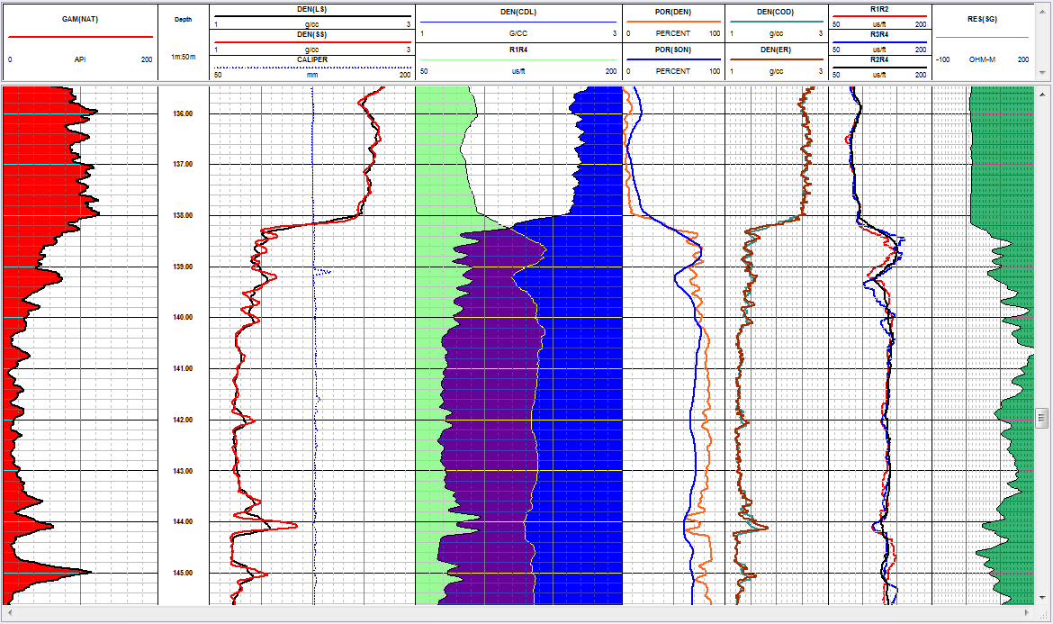

Slide 11
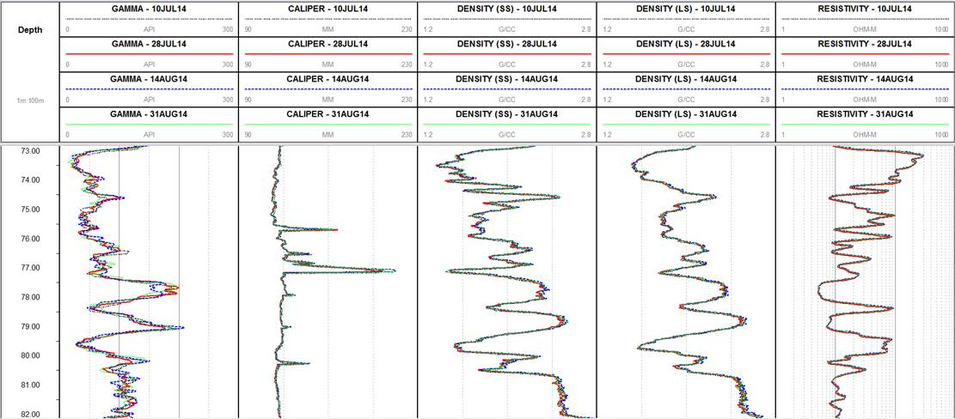
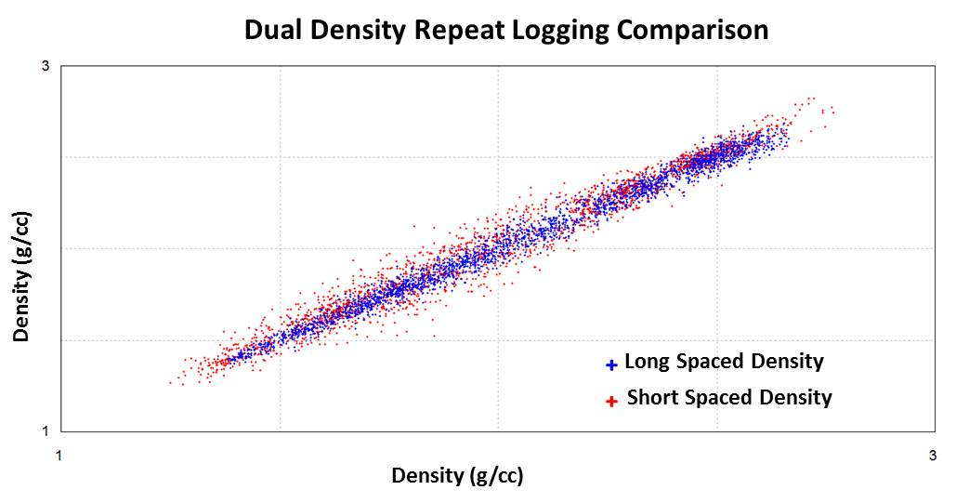
Performing Logging – Repeat Logs and Equipment Change

Slide 12
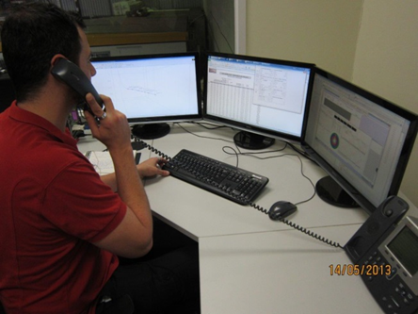
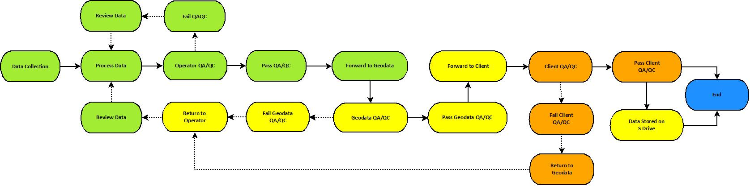
Performing Logging – Data Centre Review and Validation
Provides consistency of:
Delivery
Version Control
Data Backup

Slide 13
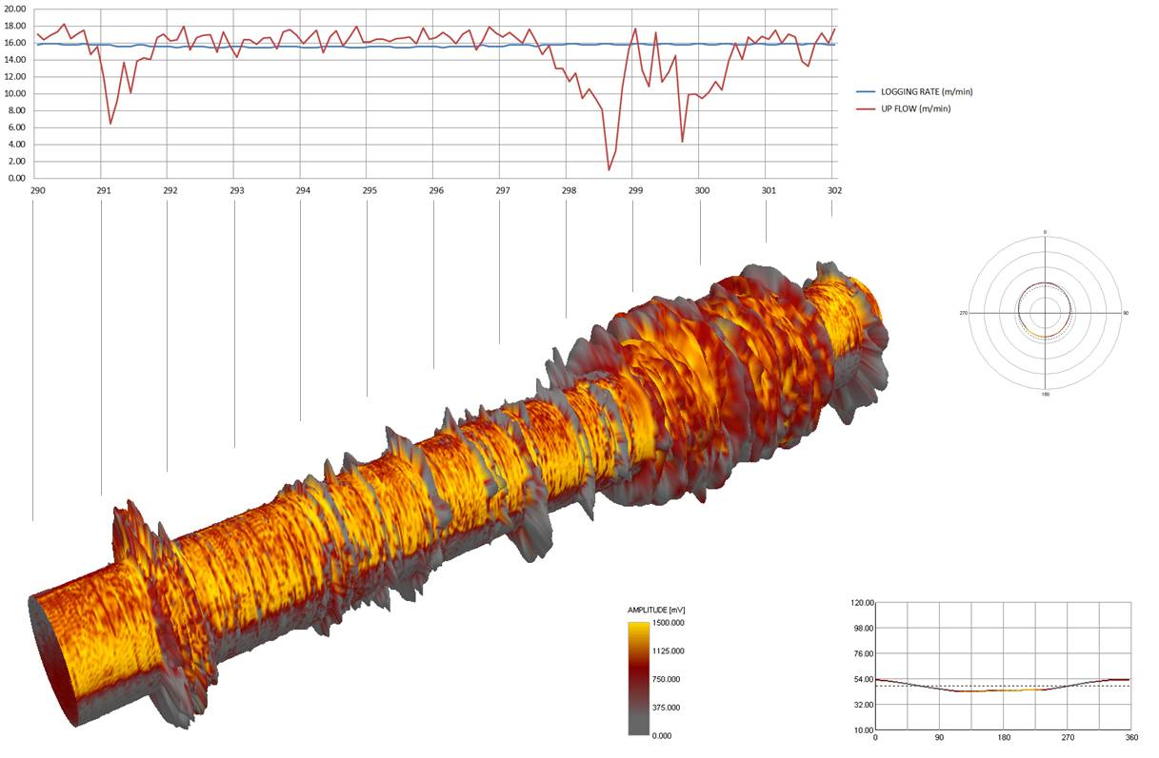
The future
Smarter use of software
Better communication technologies
Improved processes

